Slide 1



Data Analytics
Yamuna V
ENG22CT0052
Internship Coordinators:
Under the supervision of:
Neela Santhosh Kumar
HR,
Codtech IT Solutions
Dr. Ramandeep Kaur
Assistant Professor,
Dept. of CST
SoE, DSU
Dr. Hemchandra Reddy K
Assistant Professor,
Dept. of CST
SoE, DSU

Slide 2
Agenda
Must include the following, but not limited to:
About the company
Assigned Project details
Technologies used
Team and role
Results and snapshots
Conclusion
Internship Completion certificate/status

Slide 3
1. About the Company
CodTech is a platform that provides industry-oriented internship programs in various technical domains such as Data Analysis, Machine Learning, and Web Development.
The organization focuses on practical learning by assigning real-world tasks that help students gain hands-on experience.
The internship program is designed to enhance technical skills, analytical thinking, and problem-solving abilities of students.

Slide 4
2. Assigned Project
The internship project includes multiple data analysis tasks:
Exploratory Data Analysis (EDA)
House Price Prediction (Machine Learning)
Sales Dashboard Development
Sentiment Analysis using NLP
Goal: To understand real-world data handling and build practical solutions

Slide 5
3. Technologies Used
Programming Language:
Python
Libraries:
Pandas – data manipulation
NumPy – numerical operations
Matplotlib & Seaborn – visualization
Scikit-learn – machine learning
Tools:
VS Code
Jupyter Notebook
Dash & Plotly (Dashboard)

Slide 6
RESULT Task1: Big Data Analysis
Description: Performed exploratory data analysis on dataset
Steps Performed:
Loaded dataset using Pandas
Checked data using .info() and .describe()
Handled missing values
Created visualizations
Result: Identified patterns and trends
Outcome: Learned data preprocessing and visualization
16/4/2026 ENG22CT0052, Dept. of Computer Science & Technology, SoE, DSU

Slide 7
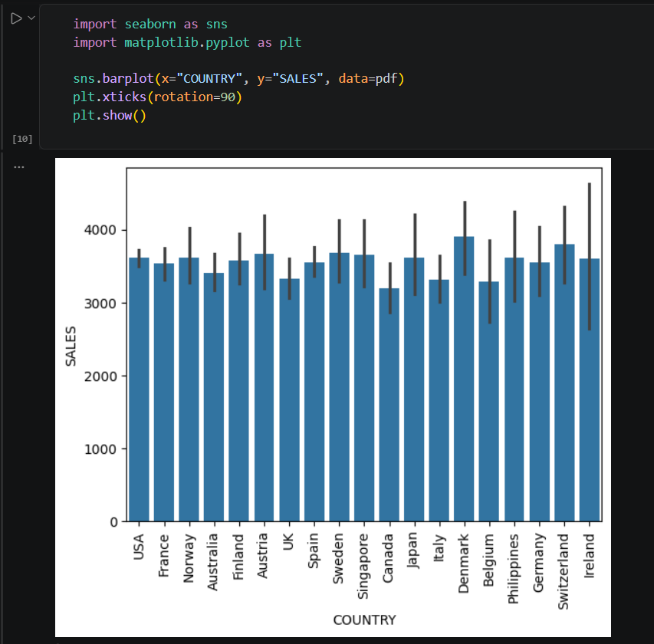
Fig 1: Sales Distribution Across Different Countries
This bar chart shows sales across different countries. It helps compare performance and identify which countries have higher or lower sales.

Slide 8
Task 2: Machine Learning(House Price Prediction)
Description: Built ML model to predict house prices
Steps Performed:
Selected features and target variable
Split dataset (train-test)
Applied Linear Regression
Evaluated using MSE & R² score
Result: Model achieved good prediction accuracy
Outcome: Learned model training and evaluation
16/4/2026 ENG22CT0052, Dept. of Computer Science & Technology, SoE, DSU

Slide 9
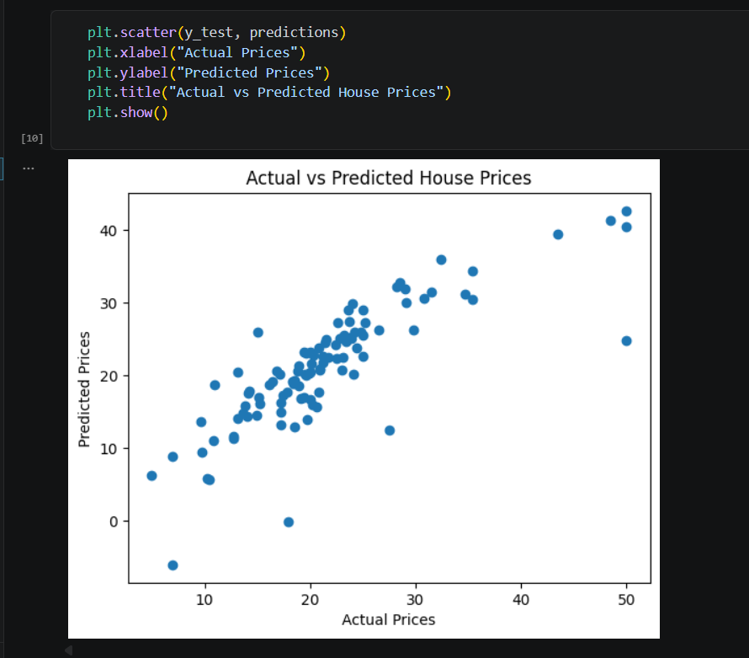
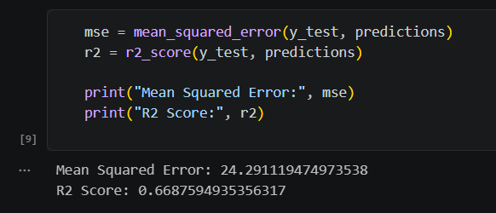
Fig 2: Model Evaluation Metrics (MSE and R² Score)
This output shows the performance of the regression model using Mean Squared Error (MSE) and R² score. The MSE indicates the prediction error, while the R² score represents how well the model explains the data.
Fig 3: Actual vs Predicted House Prices
This scatter plot compares actual house prices with predicted values from the model. The closer the points are to a straight line, the better the model’s predictions, indicating good accuracy.

Slide 10
Task 3: Dashboard Development
Description: Developed interactive sales dashboard
Steps Performed:
Loaded dataset
Created bar, line, and pie charts
Used Dash & Plotly
Added dropdown filters
Result: Interactive dashboard showing insights
Outcome: Improved data visualization skills
16/4/2026 ENG22CT0052, Dept. of Computer Science & Technology, SoE, DSU

Slide 11
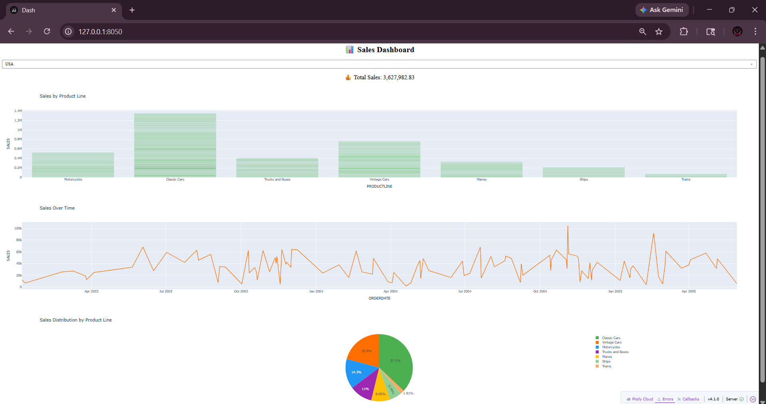
Fig 4: Interactive Sales Dashboard
This dashboard displays sales insights using interactive visualizations, including bar, line, and pie charts. It allows users to analyze sales by product line, track sales over time, and view distribution across categories.

Slide 12
Task 4: Sentiment Analysis
Description: Classified reviews into positive & negative
Steps Performed:
Cleaned text data
Applied TF-IDF Vectorization
Used Logistic Regression
Evaluated accuracy (~91%)
Result: Model successfully classified sentiments
Outcome: Learned NLP basics and text classification
16/4/2026 ENG22CT0052, Dept. of Computer Science & Technology, SoE, DSU

Slide 13
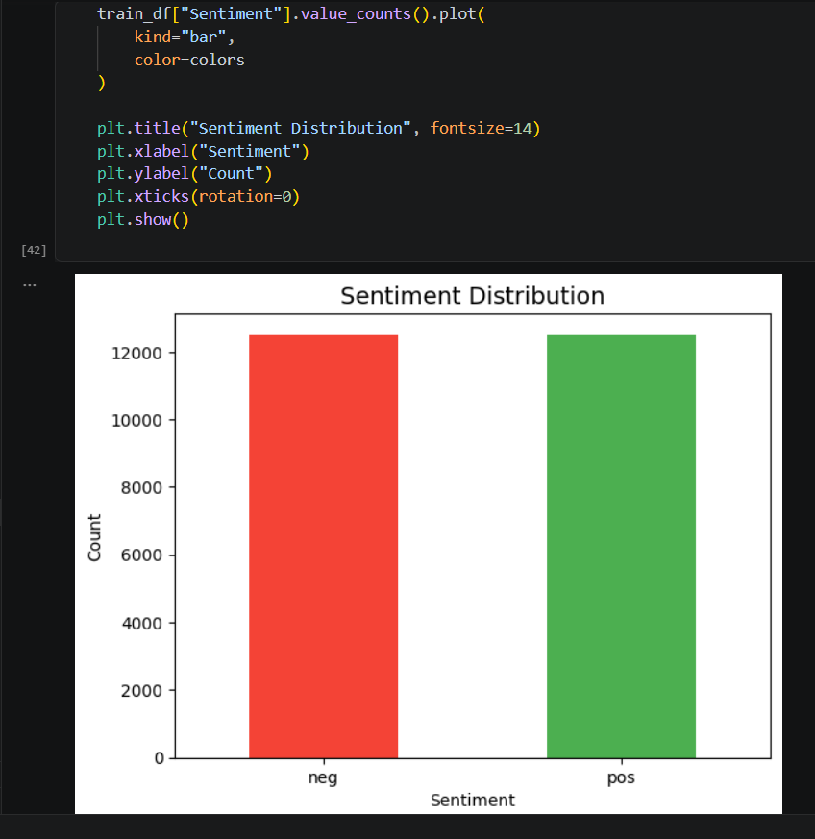
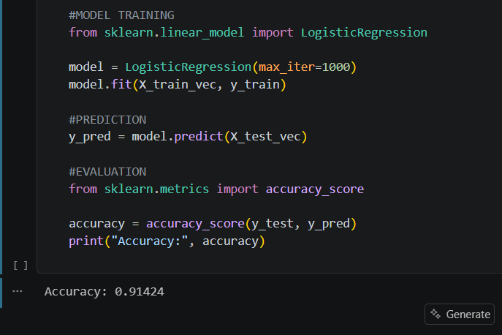
Fig 5: Logistic Regression Model Training and Accuracy
This output shows the training and evaluation of the Logistic Regression model for sentiment analysis. The model is trained on text data and achieves an accuracy of approximately 91%, indicating good performance in classification.
Fig 6: Sentiment Distribution Visualization
This visualization represents the distribution of sentiment labels (positive and negative) in the dataset. The bar chart shows that both sentiment classes are nearly balanced, which helps in reducing bias during model training. A balanced dataset improves the performance and reliability of the sentiment analysis model.

Slide 14
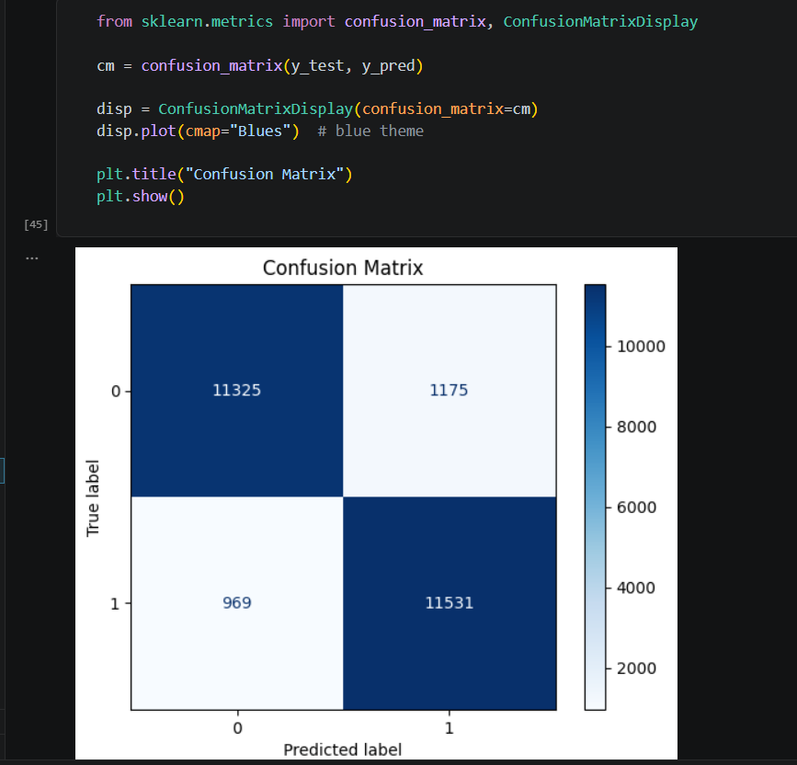
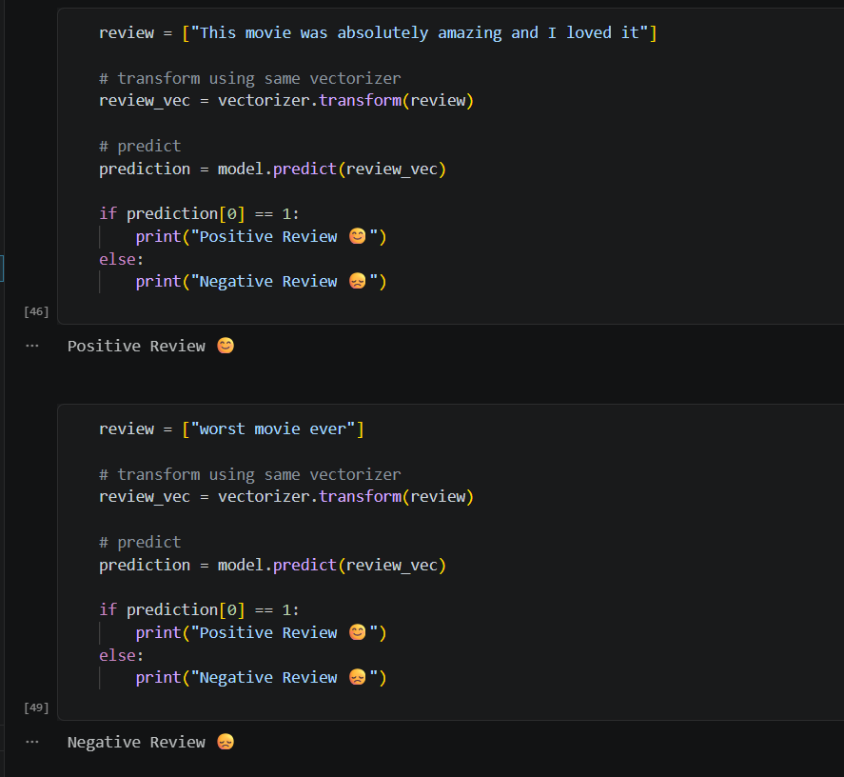
Fig 7: Confusion Matrix
This confusion matrix visualizes the performance of the sentiment analysis model by comparing actual and predicted labels. It shows the number of correct predictions as well as misclassifications, helping to evaluate how well the model distinguishes between positive and negative sentiments.
Fig 8: Sentiment Prediction on Sample Reviews
This output demonstrates the model predicting sentiment for new text inputs. The model correctly classifies a positive review and a negative review, showing its effectiveness in real-time sentiment prediction.

Slide 15
4. Conclusion
Completed full data analysis pipeline
Worked on real-world datasets
Built ML models and dashboards
Performed sentiment analysis
Skills gained:
Python
Machine Learning
Data Visualization
NLP
16/4/2026 ENG22CT0052, Dept. of Computer Science & Technology, SoE, DSU

Slide 16
5. Internship Completion certificate/status
All 4 tasks completed successfully
Project submitted
Certificate: Awaited
16/4/2026 ENG22CT0052, Dept. of Computer Science & Technology, SoE, DSU

Slide 17
Thank you

